Slide 1

StaDS@Work
Jasper Aeschlimann
20/05/2026

Slide 2

About Me
Jasper Aeschlimann
  Energy Trading Consultant
Profile
Selected Projects / Industry Expertise
  M.Sci Chemical Physics
  Professional experience as an energy quant developer and chemical physicist
  Development of energy SPOT and ancillary services price forecasts
  Analysis of BESS and development of asset dispatch optimization
  Research background in solid-state and laser physics

Slide 3
Agenda
1.)
What we do?
4
2.)
Energy storage as a trading asset
14
3.)
Price forecasting for market participation
18
4.)
Translating forecast quality into revenue
25

Slide 4
What we do?
01

Slide 5


FORRS is a leading international Strategy & Management Consultancy with focus on the entire Trading Value Chain.
We work with Clients
in Energy, Financial
and Industrial sectors

Slide 6







Our Clients
Our Sector Footprint
With deep expertise and years of successful projects, FORRS accompanies its clients along the entire Trading Value Chain.
Energy markets
& industrials
Financial Markets & Institutions
Utilities &
Infrastructure Provider
Banks & Exchanges
Renewable Asset Companies
Fund &
Asset Manager
Commodity Trader & Exchanges
Insurance Firms

Slide 7

Our International Reach
Expertise Beyond Borders
From our main offices in Germany, our projects take us across Europe, and to the Middle East, Africa, and Asia.

Slide 8
What We Do
Our Advisory Focus
Connecting markets and their players is the goal FORRS works towards every day.
To this end, we provide our customers with in-depth knowledge and best-in-class solutions that enable them to participate efficiently and profitably in markets
in times of highly
dynamic change.
Management Advisory
We focus on developing sustainable strategies and help to execute them flawlessly.
Sector Consulting
We provide deep knowledge in complex industries to deliver measurable results.
Data Driven Solutions & Digital Value Chains
We create solutions to leverage the power of accurate data and innovative algorithms
We empower our clients with digital value chains to win in today‘s ultra-fast and volatile markets.

Slide 9

Our Focus in Energy Markets & Industrials
Overview
Energy
Renewables
Commodities & Fuels
Trading Platforms & ETRM / CTRM
Market Data Solutions
Data Analytics & Data Driven Architectures
Quantitative
Methods
Algo Trading
Strategies and Technologies
Profit Optimization
Implementation​
ETRM / CTRM - Front to Back Processes and Integration​​
Management​ Business Processes, Licensing and Technology​
Leveraging legacy platforms or building new data utilization frameworks
Deal Pricing & Valuation, Risk Methods, and Market Analysis
Governance, Risk Management, Compliance
Risk Management Frameworks, Controls and Systems, Regulatory Compliance

Slide 10

Our Focus in Financial Markets & Institutions
Overview
Banking & Exchanges
Asset Management
Insurance
Frontoffice Platforms & IT Architectures
Market & Static Data Solutions
Quantitative
Methods & Data Analytics
Finance & Accounting
ESG
Implementation​ - Front to Back Processes and Integration​​, Automatic Trading
Strategy,​ Business Processes & Methods, Licensing and Technology​
ESG Frameworks, Valuations and Trading Approaches
Deal Pricing & Valuation, Risk Methods, Economic P&L, Data Science
Accounting & Controlling,
int. & loc. GAAPs,
Financial Consolidation
Governance, Risk Management, Compliance
Risk Management Frameworks, Controls and Systems, Regulatory Compliance

Slide 11
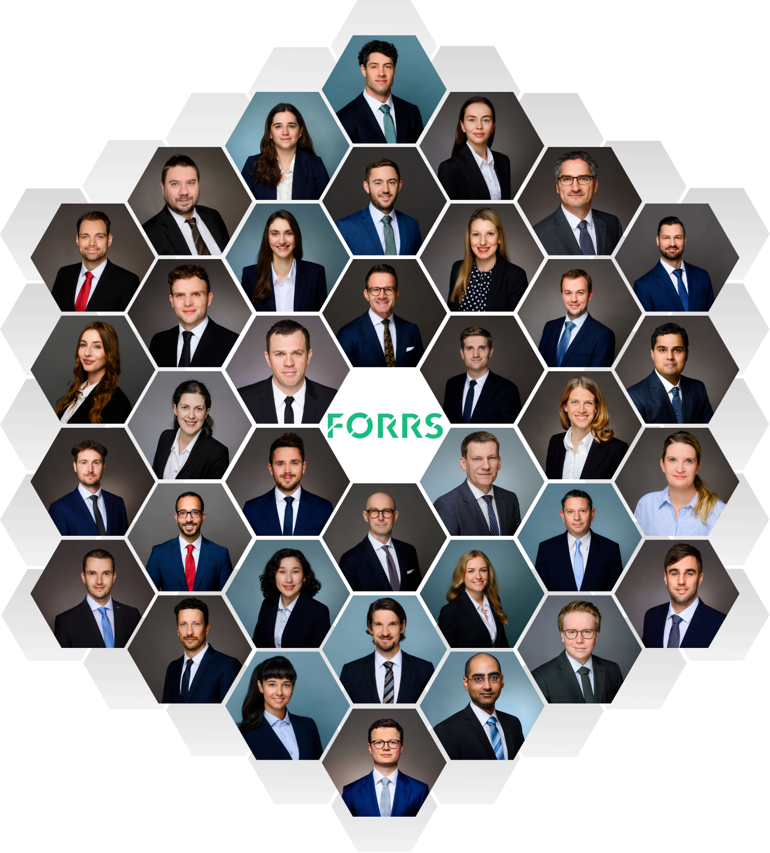
FORRS – Our Team
Foundation of Our Professionalism
We enable our clients to professionally act in their markets.
Highly interdisciplinary, diverse, and international team
Project-focused
Experienced professionals with strong strategic, methodological, and delivery capabilities
Headquarters in Germany – active beyond
150+ successfully delivered projects

Slide 12

Why FORRS?
Our Advantages
Problem-Focused –
Solution-Driven
Proven Methodology
Strong track record of balancing academic concepts and practicability, while tackling quantitative and technological challenges
FORRS Assets & Solutions
Our clients benefit by leveraging our prepared consulting services and cloud solutions
Knowledgeable Staff
We constantly invest in the skills and competencies of our people, resulting in a highly focused, well-educated, and trained team
Strong Focus
On Technology & Digitization
We rethink business in new terms — digital and technological
Deep Industry Experience
We have years of multiple successful projects and long-lasting client relationships
Clarity–Openness–Fairness
We believe in full transparency in all of our business arrangements, as evidenced by our long-term client base and business partnerships

Slide 13
FORRS – One-Stop-Shop for Companies in Energy/Commodities Trading and Financial Markets
Who We Are
What We Do
FORRS is a leading international Strategy & Management Consultancy with a focus on the entire Trading Value Chain
FORRS provides its clients deep expertise into areas such as:
  Trading platforms,
  Algo-trading,
  Quantitative modeling etc.
FORRS is a ‘one-stop-shop’ for trading companies in Energy-, Commodities- and Financial trading
Continuous Growth of FORRS Staff
FORRS is providing cloud services for data management and model management and more and more trading related capabilities
* Estimated

Slide 14
Energy storage as a trading asset
02

Slide 15
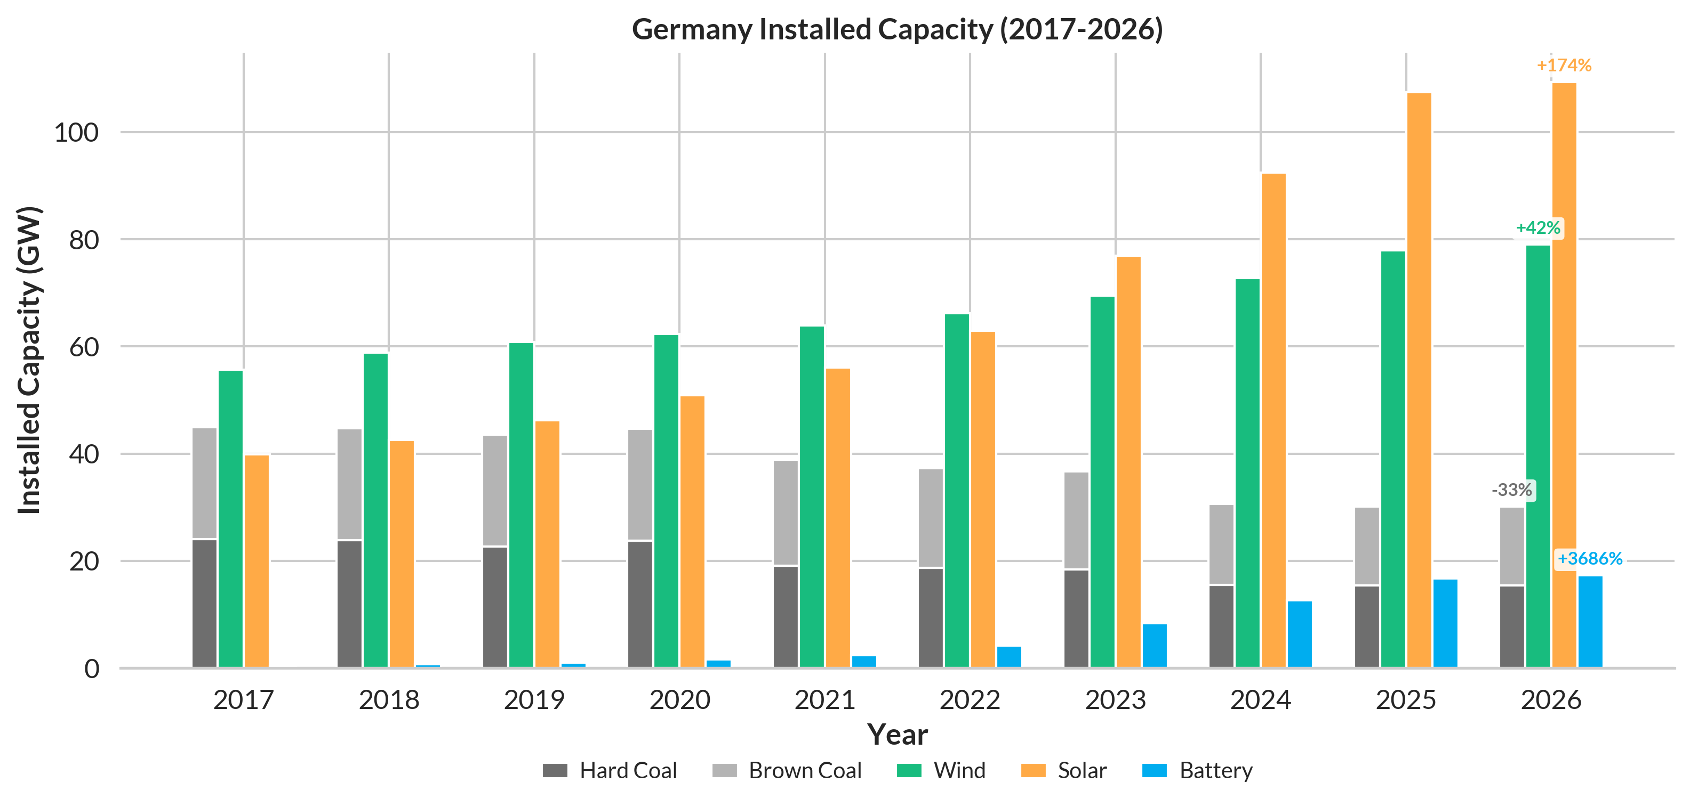
The rapidly changing landscape of energy markets has driven increased integration of flexible assets
Data Source: Energy-charts (Fraunhofer-Institut)

Slide 16
BESS asset profitability comes from optimised participation across energy spot and ancillary services markets
Day Ahead Auction
D-1, 12:00
Hourly products
Highest liquidity short term market
Intraday Continuous
Up to 5min before delivery
Continuous quarter hour products
Real-time trading
Ancillary Markets
D-1, 8:00 & 9:00
4h capacity reservation products
Stable revenue
  Each market closes at a different time — creating a sequential commitment problem under uncertainty

Slide 17
Systematic trading requires a forecast-driven dispatch architecture
Physical Layer
BESS 1
BESS ...
BESS N
External Layer
External Providers
(Meteomatics, DWD, ICE, ...)
External Markets
(EPEX, Nordpool, ...)
Energy Management System
Commercial Layer
Database
Market Price Forecasts
Dispatch optimiser
Algo trader
Aggregation Layer
Virtual Power Plant
Energy Trading Risk Management

Slide 18
Price forecasting for market participation
03

Slide 19
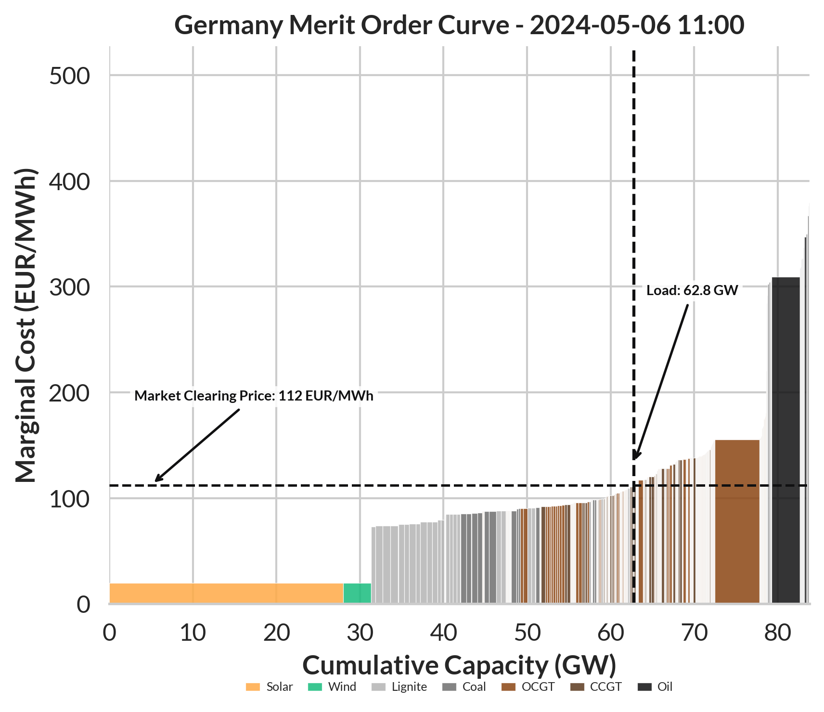
Day ahead price formation is derived from the merit order
All generation units submit bids based on their short-run marginal cost (fuel, CO₂, variable operations & maintenance)
Renewables bid at near-zero marginal cost due to zero fuel costs
The market clearing price is set by the marginal cost of the last unit needed to meet demand
Data Source: EWI Merit Order Tool 2025

Slide 20
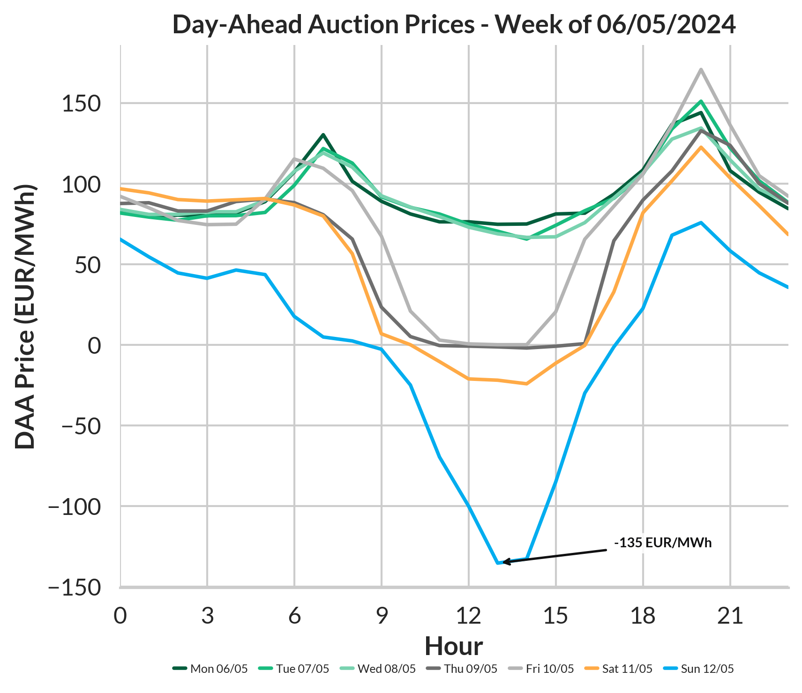
Day-ahead prices exhibit predictable periodic and structural patterns
Daily day-ahead prices exhibit two peaks in prices corresponding with the morning and evening high loads
Weekend prices are lower due to reduced demand
When renewable generation exceeds load (e.g. sunny weekends) prices can be driven negative due to inflexible baseload plants bidding against ramping down costs
Data Source: ENTSO-E Transparency Platform

Slide 21

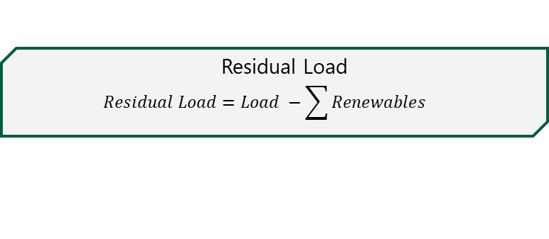
Electricity price dynamics are driven by supply, demand and structural market factors
  Residual Load
  $$Residual Load=Load −\sum{Renewables}$$
  Engineered indicators for where demand intersects the merit order curve as the primary driver of the market clearing price.
  Combined with gas prices, approximates the marginal cost of the price-setting unit
  Renewable Share
  $$Renewable Share= \frac{\sum{Renewables}}{Load}$$
  D-1, D-7 Price Lags
  Exploit strong daily and weekly autocorrelation in price series
  Additional inputs
  Weather data, gas futures price, cross-border flows, outages, German holiday flags, neighbouring market data …
  Capture non-regular price signals and structural breaks, including price spikes and demand shocks

Slide 22
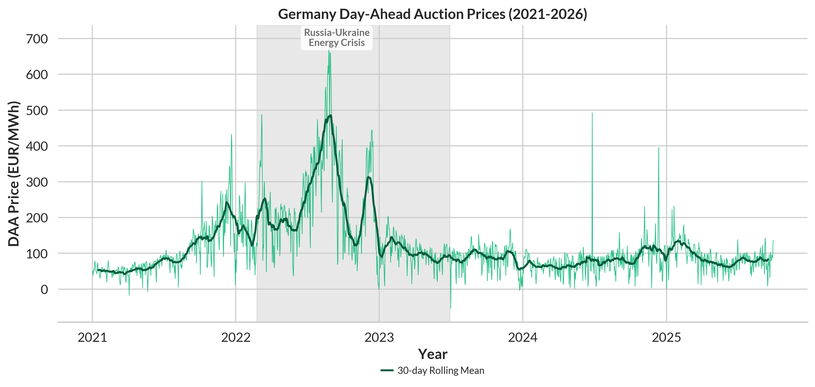
Non-stationarity in spot markets demands recency over historical depth
Data Source: ENTSO-E Transparency Platform

Slide 23
SARIMAX, XGBoost and DNN as candidate models for DAA price forecasting
Limitation
Model
Strength
  Assumes linearity
  SARIMAX
  Statistical
  Captures autocorrelation & seasonality explicitly
  Cannot model sequential dependencies natively
  XGBoost
  Gradient Boosting
  Robust to small datasets, handles non-linearity
  Requires large training data
  DNN
  Deep Learning
  Able to capture complex non-linear patterns

Slide 24
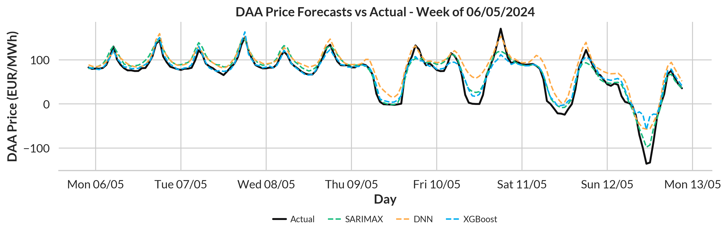
XGBoost achieves the lowest forecast error across all feature configurations
 | SARIMAX | XGBoost | DNN
2024 MAE (€/MWh) | 16 | 12 | 15
  A lightweight ML model with well-selected features outperforms complex architectures under data constraints

Slide 25
Translating forecast quality into revenue
04

Slide 26
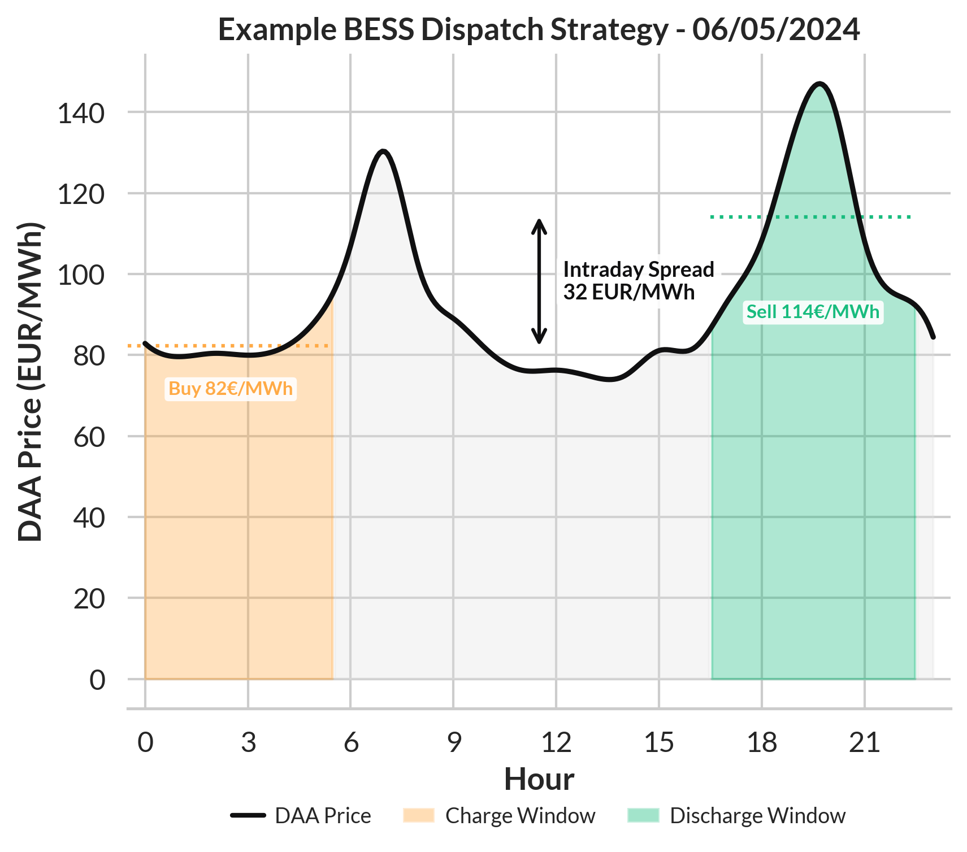

A revenue-based metric is needed to evaluate forecast quality for BESS dispatch
The optimal revenue strategy for BESS dispatch on solely the day-ahead auction is intraday arbitrage
Unlike trade portfolios, batteries contain real physical constraints in the form of state of charge
An optimiser is used to determine optimal trading decisions from price forecasts whilst maintaining constraints
Forecasting Efficiency Ratio
$$FER= \frac{\prod{forecast}}{\prod{perfect}}$$
Data Source: ENTSO-E Transparency Platform

Slide 27
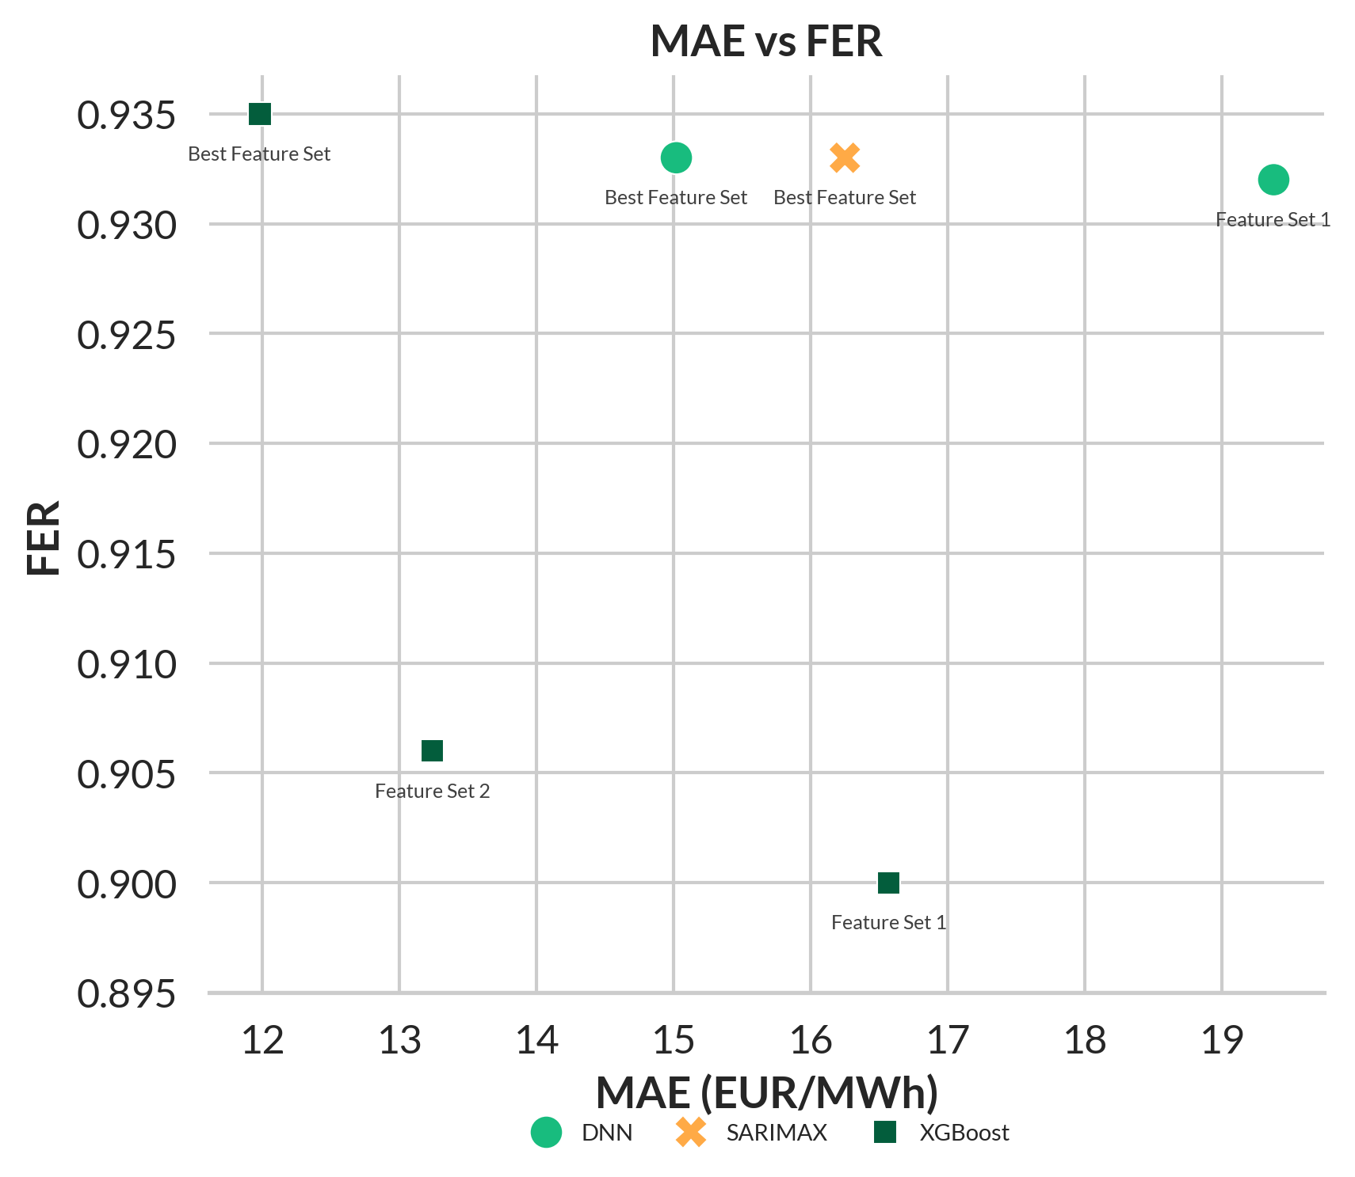
Higher forecasting efficiency ratios do not always correspond to lower MAE
Feature selection matters more than model choice
MAE and FER can diverge significantly
XGBoost with optimal features yields the best MAE and FER
FORRS analysis using FlexIndex optimisation methodology (FlexPower, 2025)

Slide 28
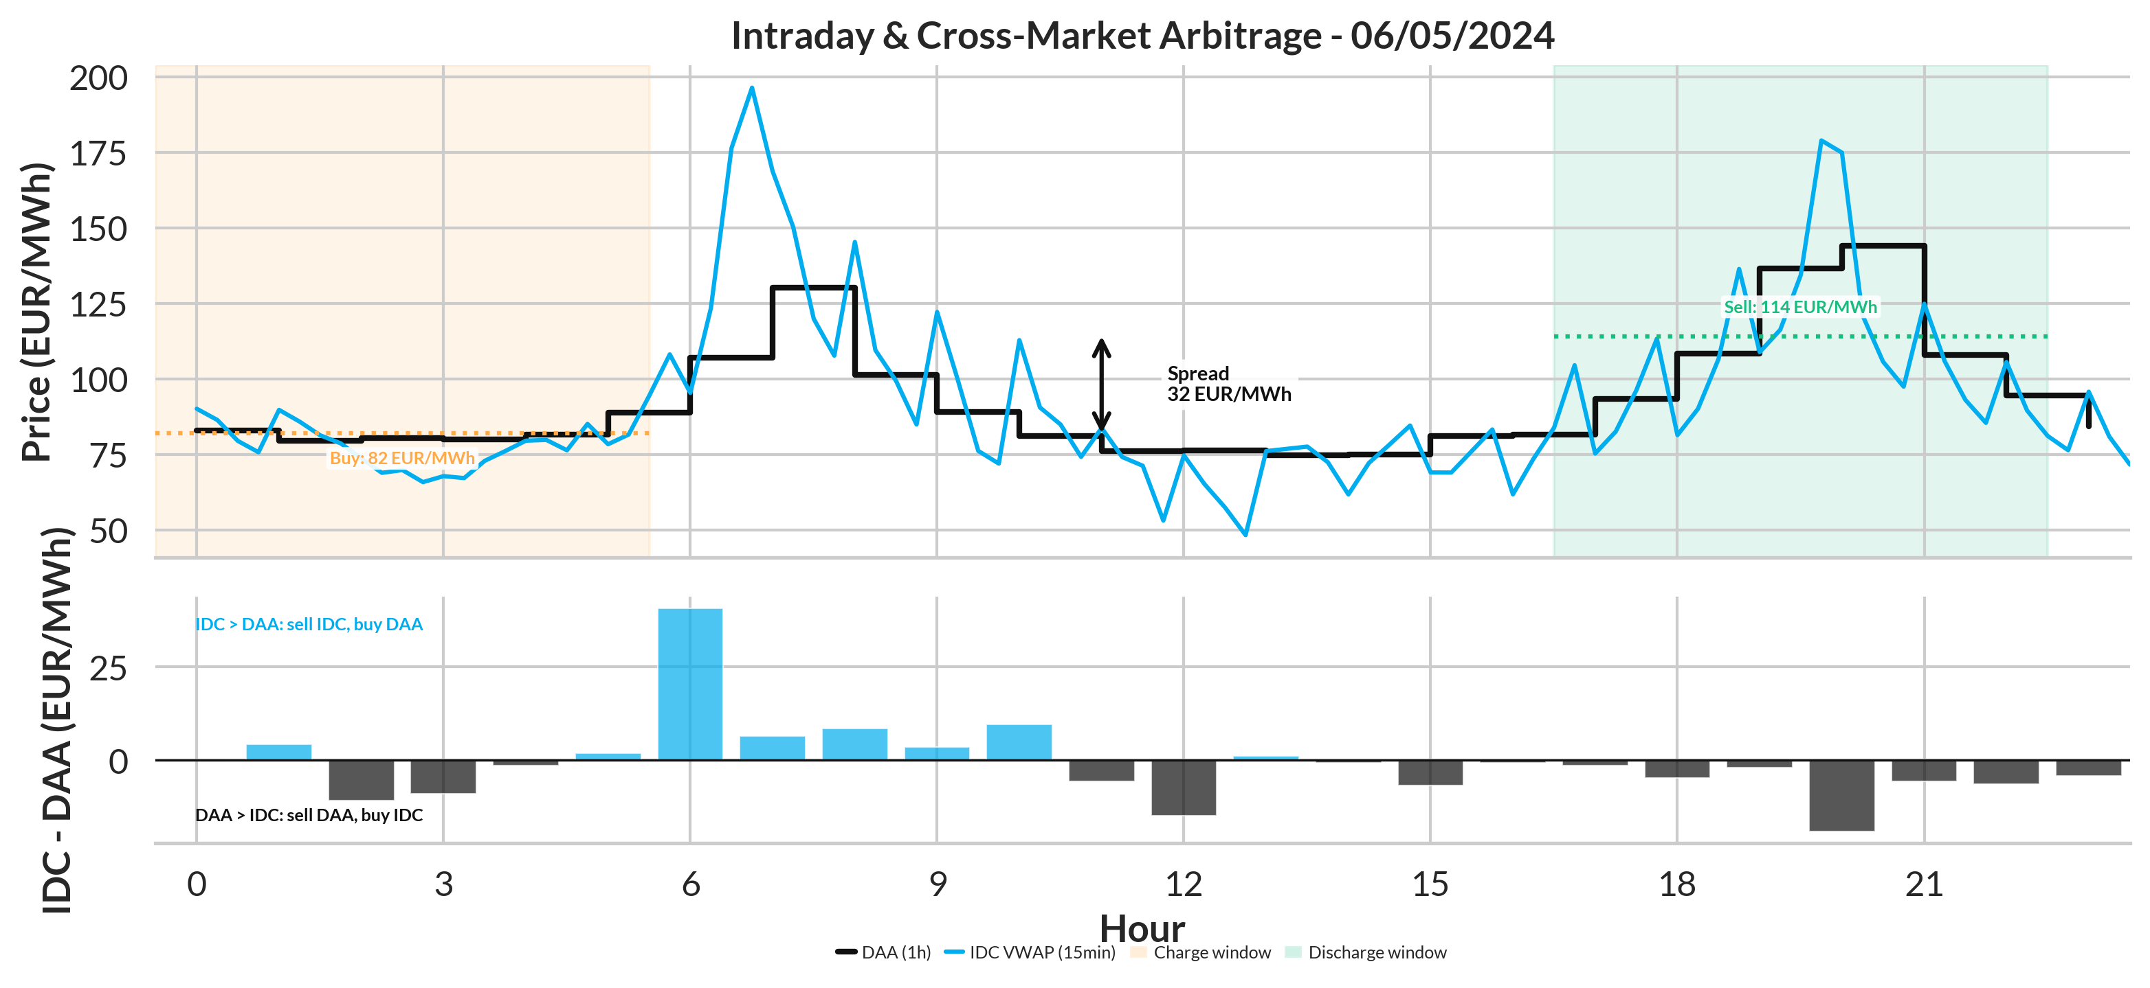
Cross-market arbitrage introduces forecast coordination challenges that MAE alone cannot capture

Slide 29

Join our Team!
Open Positions
We’re on the lookout for talented graduates in Financial Mathematics, Mathematics, Informatics, Economics, Physics, Engineering, and Data Science! Are you ready to shape the future in consulting and trading?
Interested? Scan the QR code to explore our open positions and find the perfect role for you. Let’s connect!
  LinkedIn Job Description
  Open Positions
  Website Job Description
  Other
  Open Positions

Slide 30



FORRS Office Munich
Dachauer Straße 63
80335 Munich
Markus Rieß
www.forrs.de
markus.riess@forrs.de
+49 172 815 16 72
FORRS
FORRS Office Omniturm Frankfurt
Große Gallusstraße 16-18
60312 Frankfurt am Main
Martin Otzelberger
martin.otzelberger@forrs.de
+49 173 592 26 85
@ FORRS_GmbH

