Slide 1


Slide 2

Notes:
[KS 2014 @ Uni WÜ]
About 10 years ago I was in pretty much your situation. As in this moment.
Was sitting in a lecture hall, listening to someone who presented what they do in their life. Pretty much like you are.
That evening, and what happened in the months and years after, heavily changed the course of my life and still impacts my life today.
Before getting into this deeper, may I ask you:
[Question:]
Who loves what do your for study and/work right now in your life?
=> Why do you love it?
Who knows already what they want to do after studying?
=> What is it, exactly?
Who in the BSc/MSc?
=> You still have a lot of time during your studies to explore. Use it wisely.
I was lucky that I found what I love to do early in life.
[Maths, but so what?]
I really enjoyed Maths and Coding, and quite naively started to study it.
Knowing that everyone told me „you have great career chances“ on the job market. And that „the amount of unemployed mathematicians worldwide fits into a single school bus“.
But I never *really* knew what I wanted to do, or even why.
[Back to 2014 story]
Evening I referred to, the chairman of the local student consultancy presented their organization. And it inspired me.
I felt: These people have a passion for the club, and really enjoy it. Next to their studies, of course.
Few days later, I participated in one of the weekly club meetings, became a member, and started to parcipate/lead consulting projects.
Few months later: Opportunity to join the executive board of the German wide umbrella organisation for student consultancies. Volunteered there for a year between BSc and MSc studies.
Didnt end up in consulting, but this time strongly shaped who I am today.
FIND WHAT YOU LOVE => NEXT SLIDE

Slide 3

Notes:
[Find what you love – Quote by Steve Jobs]
Youve got to find what you love.
And that is as true for work as it is for your lovers.
Your work is going to fill a large part of your life, and the only way to be truly satisfied, is to do what you believe is great work.
And the only way to do great work, is to love what you do.
If you havent found it yet, keep looking. And dont settle.
As with all matters of the heart, youll know when you find it.
If today was the last day of my life, would I do, what I am about to do today?
Whenever the answer has been no for too many days in a row, I know I need to change something.
[Hope for today]
Hope that our insights into our work inspire you to go for something enjoyable in life, too.
No matter with finccam or not.
KS
Every employee at finccam lives by this motto
90% of the time, work doesnt feel like work. However, there are always less-fun taks, like failing data imports due to customers sending wrong formats

Slide 4
finccam meets StaDS @ Work
November 6, 2024

Slide 5
Agenda
1
Introduction to finccam: Who we are & what we do
2
Research: Factor Premia as part of a Corporate Bond Investment Strategy
3
Software Architecture: Investment Strategy Framework
4
Q&A Session

Slide 6
1
Introduction to finccam: Who we are & what we do

Slide 7
Introduction to finccam
Founded in 2018, we successfully provide asset management services to our clients with a team of 17.
2018
Foundation of finccam investment GmbH as a fully licensed financial services provider in Munich
EUR 3.9 bn
Assets under Management (incl. Overlay)
17
Highly qualified staff in the areas of portfolio management, quant IT and regulatory affairs
EUR 7.9 bn
Assets under Advisory
> 15
Years duration of the longest customer and client relationships
100%
Independent and committed only to our customers
Source: finccam, August 2024

Slide 8



Our core experise
We offer three closely related services.
Risk Premium Strategies
Development and management of investment strategies for individual risk premiums and portfolios of risk premiums.
Risk Management
Development and management of risk management and tail risk hedging strategies for individual risk factors and overall portfolios.
Portfolio Construction
Efficient portfolio construction for multi-asset mandates, taking into account individual risk and return targets.
8

Slide 9
fin | ccam
Occam‘s Razor is the foundation for our style of work.
William of Occam, born about 1288 in Ockham in the county of Surrey, England and died 9 April 1347 in Munich, was a famous medieval philosopher and theologian.
An essential principle developed by Wilhelm von Occam and named after him is Occams' Razor - also the principle of parsimony. To put it simply, this principle calls for the simplest of several explanations of equal value to be chosen for a given situation. A theory is simple if it contains as few variables and hypotheses as possible and if these stand in clear logical relationships to each other.
At finccam, we consistently apply Wilhelm von Occam's principle of parsimony to the financial sector and pursue puristic investment management that focuses on the essentials.

Slide 10
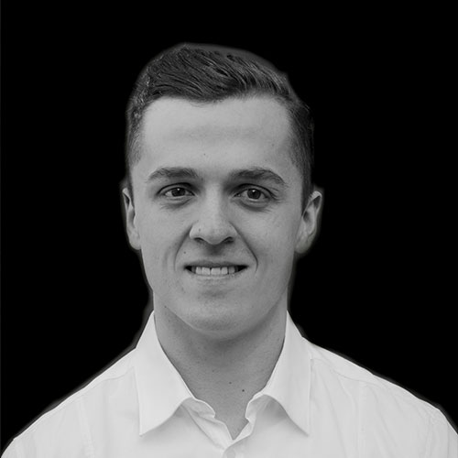
Your hosts today
Konstantin Schernstein
Joined finccam in June 2019 as a Software Engineer.
Together with our developer team, I design, implement and maintain
finccam's software infrastructure for quantitative trading and financial research.
Experience
Bachelor in Mathematics & Computer Science at University of Wuerzburg
Master in Mathematics in Data Science at TUM
Internships in data science, software development, and consulting
Former board member, advisory board member, and student consultant at
Junior Consultant Network (JCNetwork)

Slide 11
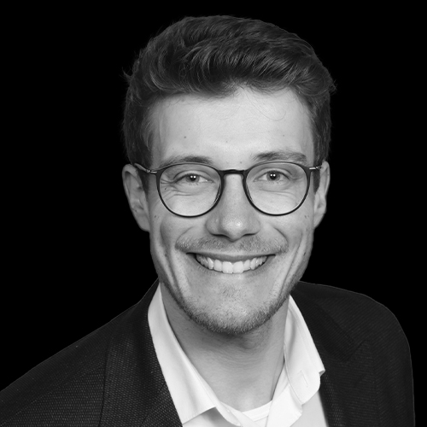
Your hosts today
Steffen Windmüller
Joined finccam in May 2024 as a Financial Engineer / Portfolio Manager.
Together with our PM team, I develop, implement and apply
risk premia and risk management strategies.
Experience
Bachelor in Industrial Engineering at Hochschule Karlsruhe
Master in Finance at University of Muenster
PhD in Finance at TUM (Prof. Kaserer)
Research assistant at TUM Chair of Capital Markets and Financial Management with visits at University of Zurich and Erasmus University Rotterdam
Worked as portfolio manager at Tecta (part of VKB) and Nexdos before

Slide 12
2
Research: Factor Premia as part of a Corporate Bond Strategy

Slide 13
Research: Factor Premia as part of a Corporate Bond Strategy
Role of Financial Engineering / Portfoliomanagent
Idea Generation
Research & Backtesting
Strategy Implementation
Execution & Trading
Maintenance & Improvement
Reporting
Market trends
Academic reserach
Client needs
Data collection
Model building
Strategy Simulation
Stress testing
Deploy model to generate trading signals systematically and rule-basd
Strong collaboration with Software Development
Order execution
Compliance rules
Transaction cost analysis
Testing framework
Managing code via Git
Automated reporting framework incl. performance attribution
We will dive into a systematic Corporate Bond Strategy today

Slide 14
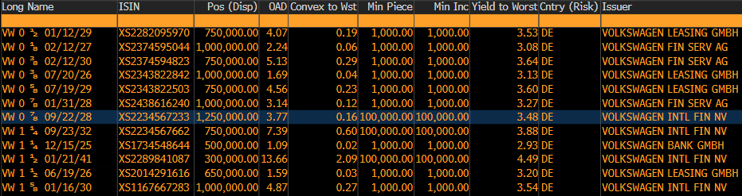
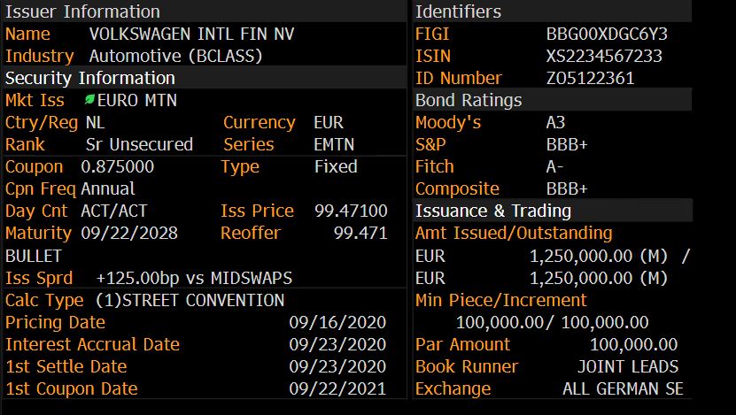
Research: Factor Premia as part of a Corporate Bond Strategy
Corporate Bonds
Numerous Volkswagen bonds outstanding:
Each bond has specific characteristics:
➔ How to select the „right“ Volkswagen bond? How to select 100 bonds systematically to construct a portfolio?

Slide 15
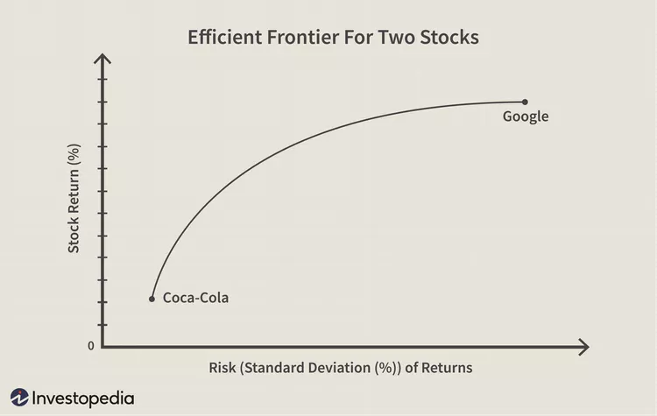
Research: Factor Premia as part of a Corporate Bond Strategy
Risk and Return
We could follow Markowitz and combine the bonds to maximize the portfolio return for a provided risk level.
65% Coca-Cola,
35% Google
Risk Limit
➔ How to estimate the returns of corporate bonds?

Slide 16


Research: Factor Premia as part of a Corporate Bond Strategy
Estimating the return for Corporate Bonds
The return for a corporate bond can be defined as follows:
It can be further decomposed:
$$r_{i,t+1} =y_{i,t}+E_{t}\left[\frac{∆P_{i,t+1}}{P_{i,t}}\right]+ε_{i,t+1}$$
Carry
Expected Yield Changes
$$r_{i,t+1}≅\left(y_{i,t}^{τ}−y_{t}^{f,τ}\right)+\left(y_{t}^{f,τ}\right)−D_{i,t}^{mod}×\left(\left(E_{t}\left[y_{t+1}^{f,τ−1}\right]−y_{t}^{f,τ−1}\right)+\left(E_{t}\left[S_{i,t+1}^{τ−1}\right]−S_{i,t}^{τ−1}\right)\right)$$
Credit Spread
Treasury yield
Exp. Change of the Treasury Yield for time to maturity$τ$
Exp. Change of the Credit Spread
We calculate various factors driving the Expected Changes in the Credit Spread
Factors have been shown to generate returns beyond the carry, i.e., Factors carry so called “Factor Premia”

Slide 17
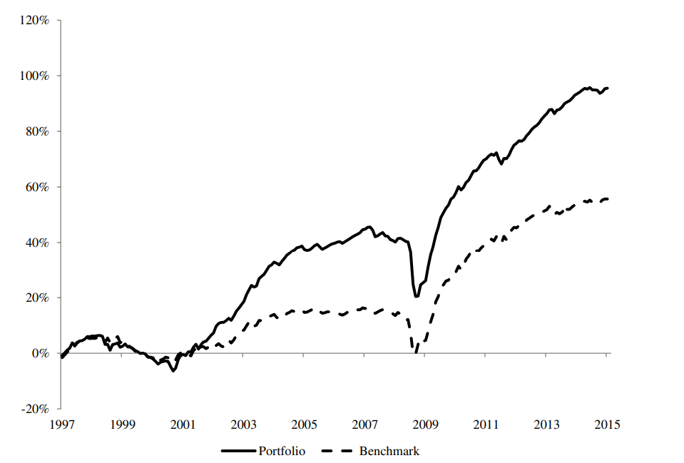
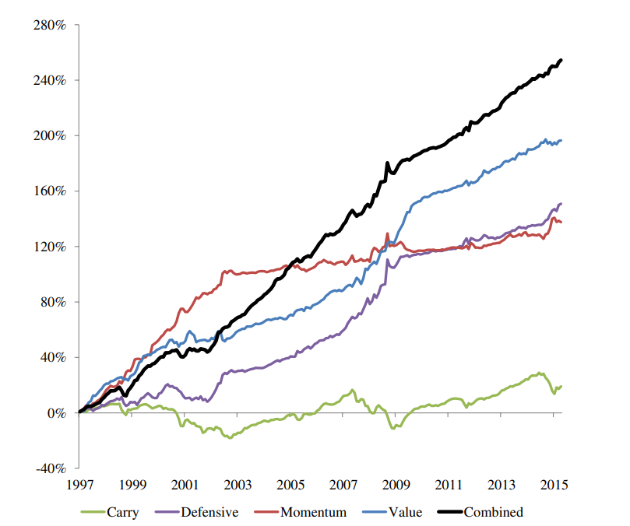
Research: Factor Premia as part of a Corporate Bond Strategy
Corporate Bond Factor Premia
There are certain factors driving corporate bond returns. We would like to harvest these factor premia.
Portfolios with exposure to these factors can be constructed by using bond characteristics
Combining different characteristics, multiple factor premia can be „harvested“ in a more robust fashion
Source: Israel et al. (2018) - Common factors in corporate bond returns

Slide 18
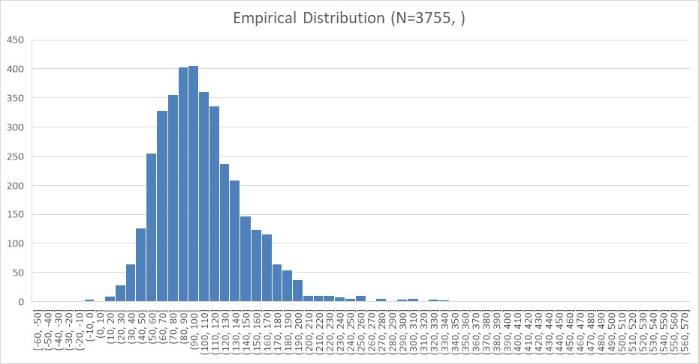
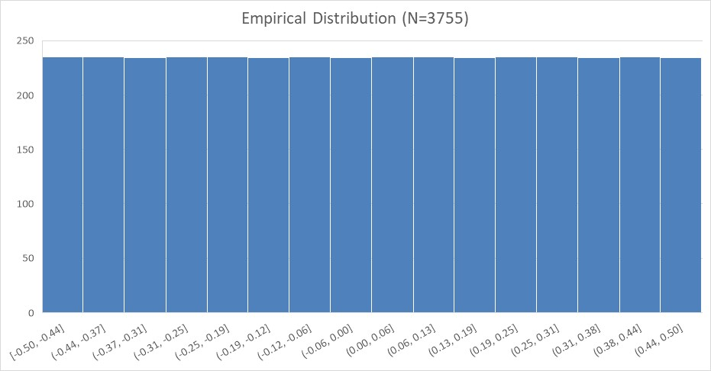
Research: Factor Premia as part of a Corporate Bond Strategy
Combining multiple „factor premia“ characteristics
Empirical distribution of a characteristic suffers from outliers, non-normal distribution and/or missing data
Mean: 104
Median: 98
Min: -59.7
Max: 568.7
Mean: 0
Median: 0
Min: -0.5
Max: 0.5
We apply the following steps on the variable:
rank-transformation
de-meaning
scaling the interval [-0.5, 0.5] by dividing through the maximum and multiplying with 0.5
We loose information by rank-scaling a continuous variable to generate a “bucketing” or “binning” view. This view enables us to easily aggregate information across different variables and use it for further applications (e.g., regression analysis). We can apply the transformation in an issuer-neutral fashion to choose the best bond per issuer.

Slide 19
3
Software Architecture: Investment Strategy Framework

Slide 20




PM
Scheduler
PM
Service
Trading App
Signal Monitoring
Backtesting App
Start trading process
Start signal calculation
Start backtest
Trade Builder
Investment Strategy
Backtest
Reallocation
Trigger: Do we trade today?
Selection: Which instrument?
Quantity: How many?
…
Calculate
signal & transactions
for a single day
Calculate
signals & transactions
historically
Engine
Calculate backtest results and statistics
Build proposal
Trade Proposal
Signal
Transactions
Backtest result
Database
Relational DB
Result Storage
Notify PM, display in trading app, use for calculations, …
Analyse in dashboards, use for pitch decks, …

Slide 21
Reallocation
Trigger: Do we trade today?
Selection: Which instrument(s) do we want to trade?
Quantity: How many contracts/shares/notional do we want to trade?
Notional: What is the reference notional for the trades?
Weight: What are the current and target weights (for certain asset categories, currencies, …)?
Action: Generate the final trade vector, e.g. by comparing current and target portfolio.
Example: Corporate Bond Strategy
Notional: Determine how much we want to invest, e.g., EUR 100 Mio.
Selection: Create an optimal portfolio of N bonds with the highest expected return given portfolio constraints (risk, ESG) ➔ derive optimal quantity from optimal weights and target notional.
Trigger: Compare the optimal portfolio quantity to the current portfolio quantity.
Action: Derive the final trade vector including quantity and security prices.

Slide 22
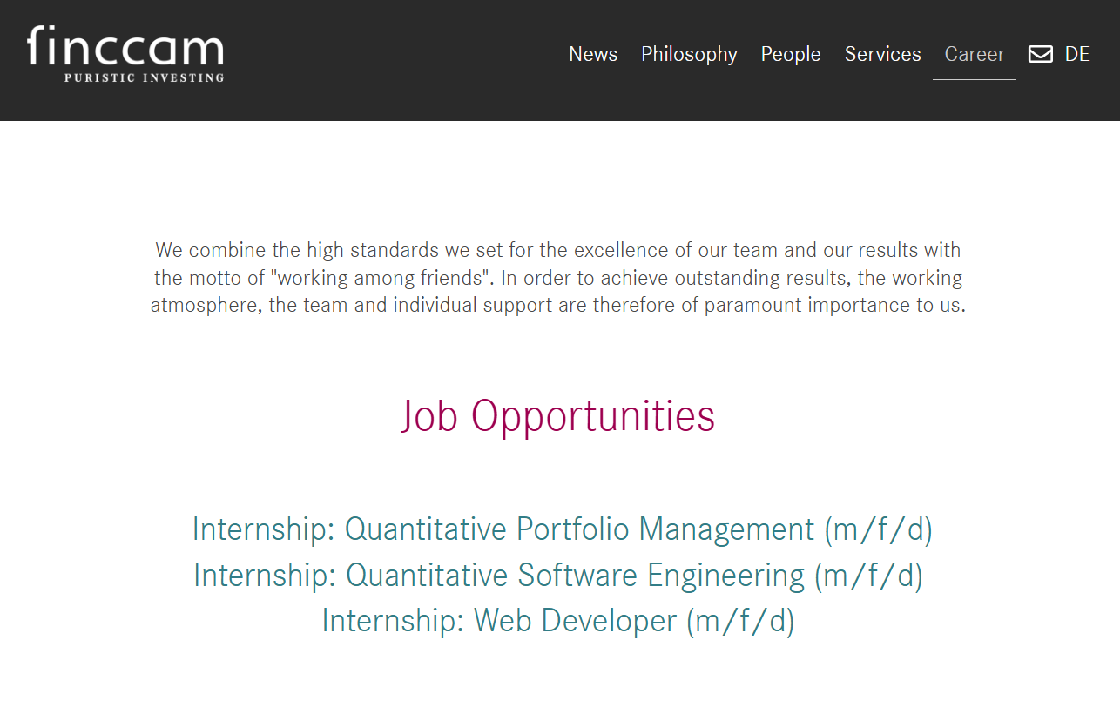

Slide 23
3
Q&A
Notes:
What does a typical working day look like?
Konstantin
7.30am: Deep work 1 on the most impactful and important task of the day.
9am: 15 min daily meeting with our entire team, mainly on business and client updates (hybrid work setting).
9.15am – 9.30am: Project team updates. Check Teams and E-Mail communication.
10am – 11.30am: Deep work 2.
11.30am – 12am: Projekt planning/design meeting.
12am – 1pm: Lunch with all colleagues in the office.
1pm – 3pm: Deep work 3.
3pm – 5pm: Coordination work with the team.
Steffen (only differences as compared to Konstantin)
I start at 8.00 am and finish at 5.30 pm
Between 3-5 pm, I occasionally trade if required.
What is the starting salary?
Depends on role and experience. 70+20 realistic for junior position.
How does one typically join your company? (immediately permanent position/trainee/working student/internship before)
Preferred with previous working student or internship position.
How much coding is typically done?
Most junior employees spend more than 70% coding. Reduces slightly with seniority (natural development).
Almost all portfolios manager code, too.
What statistical software is used?
- R
How many hours are worked per week?
40-50
More is possible when onboarding new clients or other projects with tight dealines
What (academic) background are my potential colleagues from?
- Mathematics, Finance, Computer Science, Physics
What background do my future colleagues typically have?
Portfolio Management, Quantitative Finance, Software Engineering
Which programming languages and tools do you use? Can I choose my own?
Languages: Python, R, C#, Azure services. Languages may be added if it makes sense, but we want to keep our tech stack small.
Tools: Whatever you need.
Is there an onboarding for new employees?
Introduction to all business lines, software services, close mentoring on first projects

